Slide 1



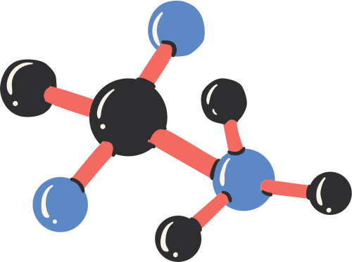
Welcome to our Presentation
Data & Information

Slide 2



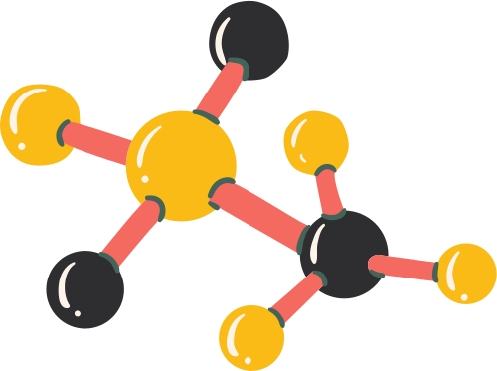

Md. Najmus Sakib
ID: 221-15-5127
Section: 61_A

Slide 3



Data & Information
DATA: Data is defined as a collection of individual facts or statistics. Data is a small piece of information.
INFORMATION: Information is created by combining multiple data. Data processed by machines giving information.

Slide 4



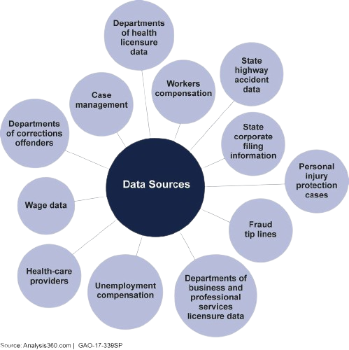


Data Sources

Slide 5

Jannatul Ferdous Riva
ID: 221-15-4928
Section: 61_A

Slide 6
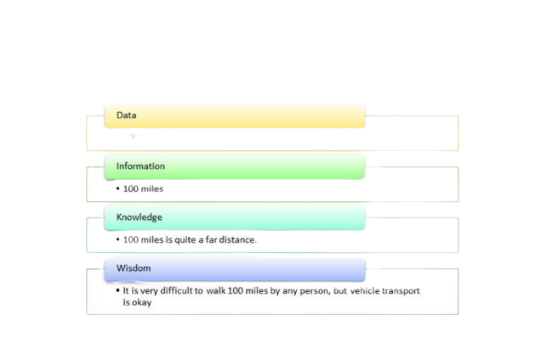
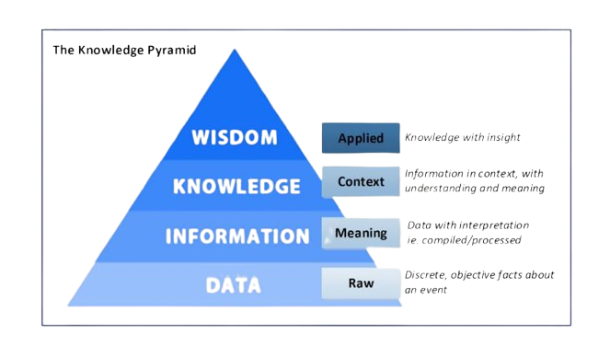
Data to Wishdom
DIKW Pyramid

Slide 7



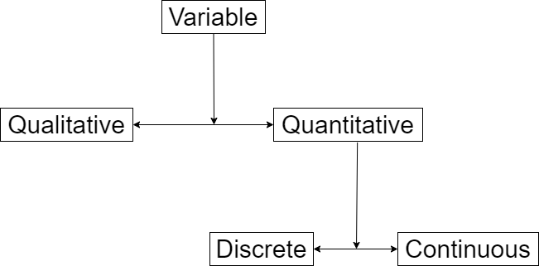

Types of Data

Slide 8

Nasima Akter
ID: 221-15-4755
Section: 61_A

Slide 9





Scale of Measurement
We can determine the scale of measurement based
on the type of data that a variable contains, this scale
of measurement is the nature of the data.
Nominal
Ordinal
Interval
Ratio

Slide 10
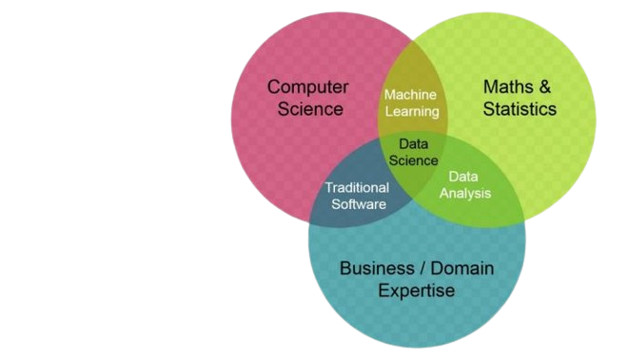

Data science is the science of transformation of data into actionable insights
Data Science Venn Diagram

Slide 11





Thank You

